Slide 1
Adherence to Pediatric Massive Transfusion Protocol: Impact of an APP-Led MTP Response Team
Chance Basinger, MPA, MPAS, PA-C
IMC Trauma Services
Pediatric Trauma/General Surgery

Slide 2
MTP at Primary Children’s Hospital

Slide 3
Primary Children’s MTP Protocol
PCH MTP Protocol Implemented 5/2022
Creation of an APP-led MTP Team:
- Trauma APP
- ED Trauma Nurse
- ED Tech

Slide 4
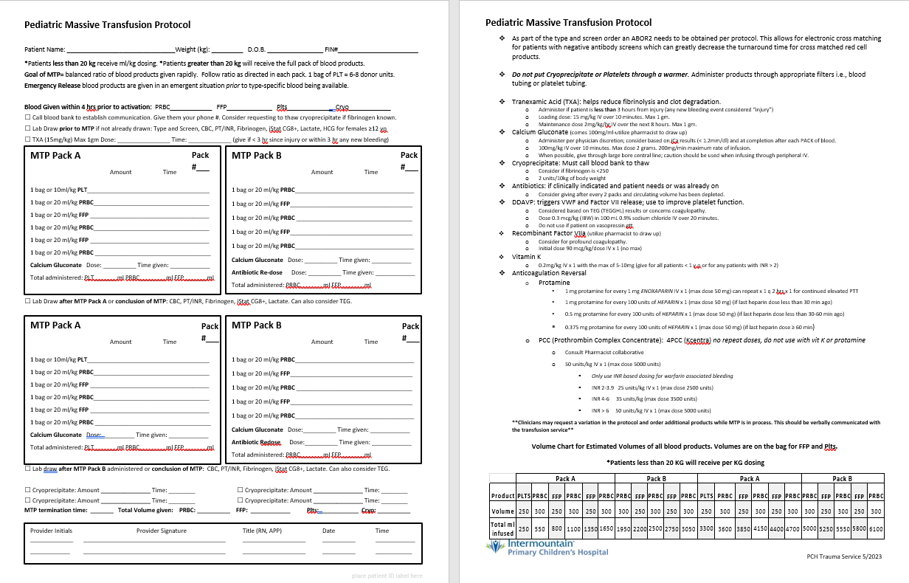

Slide 5
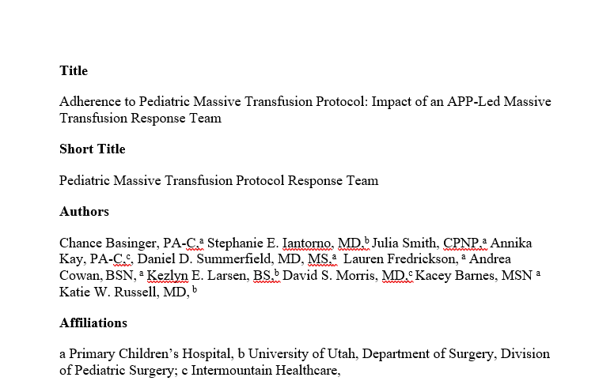
Adherence to Pediatric Massive Transfusion Protocol

Slide 6
Introduction
The need for massive transfusion (MTP) is relatively rare in children, which may lead to inconsistent transfusion practices and failure to administer a balanced blood product resuscitation.
Low Volume, High Consequence Event
The aim of this study is to assess the effectiveness of an Advanced Practice Provider (APP)-led MTP response team at our institution.

Slide 7
Methods
Single-center retrospective cohort study utilizing data from March 2019-March 2023
Patients included if they met criteria for MTP activation and received 40 mL/kg of blood product after activation of the MTP
Primary Outcome: Receipt of a balanced massive transfusion, defined as the ratio of infused PRBCs to FFP being less than or equal to 1:1.4, including the NICU 1:1.8 due to coagulopathy resuscitation
Secondary Outcomes: Cryo, TXA, Factor VII, Calcium, DDAVP, Mortality

Slide 8
Patient Characteristics
Table 1. Patient Characteristics
Characteristic | Pre-Implementation, N = 16¹ | Post-Implementation, N = 20¹ | p-value²
Age |  |  | 0.2
< 1 yr | 2 (12%) | 8 (40%)
1 - 4 yrs | 2 (12%) | 4 (20%)
10 - 14 yrs | 6 (38%) | 3 (15%)
15 - 17 yrs | 3 (19%) | 1 (5.0%)
5 - 9 yrs | 3 (19%) | 4 (20%)
Sex |  |  | 0.2
Female | 5 (31%) | 11 (55%)
Male | 11 (69%) | 9 (45%)
Race |  |  | 0.7
Asian | 0 (0%) | 1 (5.0%)
Other | 6 (38%) | 9 (45%)
Unknown | 1 (6.2%) | 0 (0%)
White | 9 (56%) | 10 (50%)
Ethnicity |  |  | 0.5
Hispanic or Latino | 4 (25%) | 9 (45%)
Not Hispanic or Latino | 10 (62%) | 10 (50%)
Unknown | 2 (12%) | 1 (5.0%)
Trauma Patient | 6 (38%) | 7 (35%) | 0.9
Patient Location at start of MTP |  |  | 0.8
CICU (Cardiac ICU) | 1 (6.2%) | 0 (0%)
ED | 4 (25%) | 6 (30%)
Floor | 0 (0%) | 2 (10%)
NICU (Neonatal ICU) | 1 (6.2%) | 3 (15%)
OR | 6 (38%) | 6 (30%)
PICU (Pediatric ICU) | 3 (19%) | 2 (10%)
Radiology | 1 (6.2%) | 1 (5.0%)
¹n (%) ²Fisher's exact test; Pearson's Chi-squared test

Slide 9
Results
36 patients met our inclusion criteria:
-16 (44.4%) during the pre-implementation period
-20 (55.6%) during the post-implementation period
When compared to the pre-implementation cohort, a significantly greater proportion of the post-implementation cohort received a
- Balanced resuscitation 25% pre vs. 85%, post, p<0.001
- Cryoprecipitate 31% pre vs. 70% post, p=0.02
- TXA 19% pre vs. 75% post, p<0.001
There were no significant differences between cohorts with respect to age, sex, race, ethnicity, history of trauma, location of transfusion, Factor VII, calcium, redosed antibiotics, Vitamin K, desmopressin acetate, or mortality (p>0.05).

Slide 10
Pre and Post Implementation Comparison
Table 2. Comparison of Patients who Received Product and Mortality Before and After Implementation of APP-Led MT Team
 | Pre-Implementation, N = 16¹ | Post-Implementation, N = 20¹ | p-value²
Balanced Transfusion | 4 (25%) | 17 (85%) | <0.001
Cryoprecipitate | 5 (31%) | 14 (70%) | 0.02
TXA | 3 (19%) | 15 (75%) | <0.001
Factor VII | 3 (19%) | 5 (25%) | 0.7
Calcium | 14 (88%) | 20 (100%) | 0.2
Antibiotics Redosed | 7 (44%) | 12 (60%) | 0.3
Vitamin K | 1 (6.2%) | 5 (25%) | 0.2
DDAVP | 1 (6.2%) | 4 (20%) | 0.4
Mortality | 8 (50%) | 13 (65%) | 0.4
¹n (%)
²Pearson's Chi-squared test; Fisher's exact test

Slide 11
Side Benefits
Increased communication with Blood Bank
Better Documentation
Including time from activation to administration
Median ~ 7 min
Total Product Delivery
Increased APP autonomy, Practicing at the top of Scope

Slide 12
Conclusion
A significant improvement in balanced resuscitation was achieved after the implementation of an APP-led MTP team at our institution.
Next Steps:
Integration of LTOWB
- TEG Directed Resuscitation

Slide 13
Thank you

Slide 14
Questions?

Slide 15
Massive Transfusion in Children

Slide 16
Definition of MT in Children
No Standardized Definition has been created
Pediatric MT definitions have primarily relied on the volume of blood products transfused relative to the estimated blood volume for the child over a specific period.
Simplistic, arisen due to limited availability of pooled patient data with sufficient granularity
Most recent study, children treated in a combat setting found that administering around half of the total blood volume within 24h could effectively identify critically injured children at risk of mortality
Survival Bias

Slide 17
Ratios of Blood Products
Adult Transfusions vs Pediatric Transfusion
Most robust evidence regarding the optimal ratios of blood products comes from the adult trauma literature and various prospective observational trials conducted during the US military’s transfusion practices in Iraq and Afghanistan
The Journal of Trauma 2007
Study found that the high ratio of 1:1.4 was independently associated with improved survival
Pragmatic Randomized Optimal Platelet and FFP Ratios (PROPPR)
Prospective Observational Multicenter Major Trauma Transfusion (PROMMTT)
PROPPR and PROMMTT provided clinical justification for investigating the advantages of balanced transfusions in pediatric trauma patients

Slide 18
10 Leading Causes of Deaths, United States
2020, All Races, Both Sexes, Ages: 1-18
Notes:
MV Traffic, Poisoning, Drowning, Suffocation, Fire/burn, Other Land Transport, Firearm Pedestrian, Other Natural/ Environment Fall Struck by or Against

Slide 19
Leading Causes of Death among Children and Adolescents in the United States, 1999-2020
Notes:
Firearms are now the leading cause of death in children, on average 11 children a day die from firearm-related injuries, ONE THIRD of those deaths are the result of SUICIDE

