Slide 1





National Management Trends in Pediatric Splenic Trauma a Database Study – Are We There Yet?
R Scott Eldredge MD*, Brielle Ochoa MD, David Notrica MD,
Justin Lee MD,
Notes:
Thank you for the opportunity to present today.

Slide 2

I do not have any relationships to report with ACCME defined ineligible companies.
I will not be discussing unlabeled/investigational uses of medical devices or pharmaceuticals during this presentation.
Notes:
We have no disclosures

Slide 3



Blunt Traumatic Splenic Injury
Traumatic injury is leading cause of death in pediatric aged patients – 4.5 million non-fatal injuries annually
Solid organ injury in 10 – 22% of blunt abdominal trauma
  Spleen is the most common solid organ injured
APSA Guidelines for Blunt Spleen injury:
  Hemodynamically stable = Nonoperative management
Notes:
Traumatic injury remains the leading cause of death in pediatric patients nationally.
Blunt traumatic abdomen injuries – are accompanied by solid organ injury in 10 – 22 % of cases with splenic injury being the most common solid organ injured.
Evidence based guidelines first published in 2000 by APSA, and reiterated by other committees including EAST, ATOMIC, - recommend nonoperative management in the hemodynamically stable patient.

Slide 4
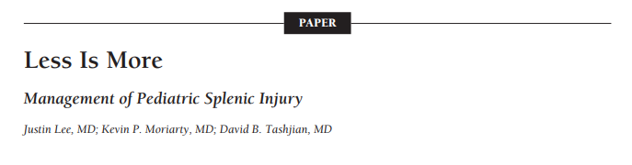

Splenic Injury Intervention
Notes:
In 2012 Lee et all published a national review of splenic injury cases and their associated management between 2000 – 2008

Slide 5
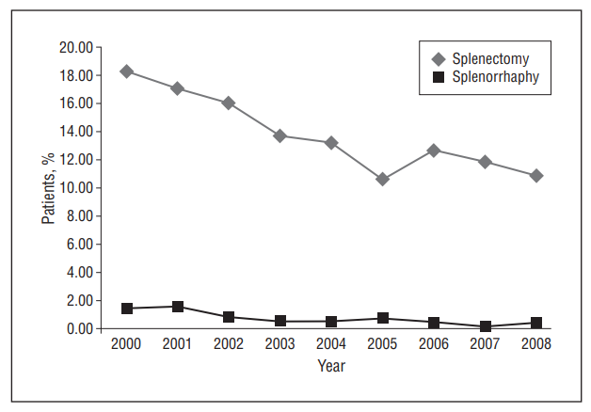
Splenic Injury Intervention
18.25%
10.86%
Notes:
Folloiwng APSA guideline implementation – splenectomy decreased from 18 to 10%.

Slide 6
Aims
Determine the contemporary national trends of non-operative management of pediatric blunt splenic injury
Determine which factors contribute to nonoperative management of pediatric blunt splenic injury
Compare the hospital charges between operative and nonoperative management in pediatric blunt splenic injury
Notes:
Given that this study was published 10 years ago – we sought to
first determine the contemporary national trends of non-operative management of pediatric blunt splenic injury.
Second identify factors that are associated with successful nonoperative management in these patients
And determine the economic burned of operative management

Slide 7





Methods
Kid’s Inpatient database (KID) queried
  2012
  2016
  2019
ICD9 and 10 Codes
≤ 16 years
Notes:
To do this we conducted a retrospective review of the most recent KIDs inpatient database spanning from 2012 to 2019.
The KIDs data base provides national estimates of healthcare utilization, hospital charge , and outcomes for hospitalized patients younger than 21 years of age. The number of states who contribute to KID includes 48 states plus the District of Columbia.
Patients were identified using ICD 9 and ICD10 codes. Patients were excluded if diagnostic codes were suggestive of an “open” abdominal injury
Further patients were included if they were 16 years or younger

Slide 8
Methods
Nonoperative
Demographics
Injury grade
Hospital factors
Hospital Charges
Angioembolization
Operative
Notes:
Following patient identification, demographics, splenic injury grade, hospital factors (child vs adult, academic vs private), and hospital charges were selected.
Further patients were stratified by management – nonoperative, angioembolization, and operative.
Comparisons between management groups were made in respect to patient factors, injury grade, hospital factors, and hospital charges/outcomes

Slide 9


Demographic and characteristics
8,296 cases of blunt splenic injury
  Male – 69.0%
  Female – 31.0%
Splenic injury Grade
Grade I – 16.6%
Grade II or III – 43.1 %
Grade IV or V – 40.3%
Hospital characteristics
74.3% Adult hospital vs 25.7% Pediatric hospital
Notes:
8,296 cases of blunt splenic injury were identified over the entire study period, with the majority of injuries being identified in male patients.
Approximately 75% of cases were cared for at adult designated hospital.
16% of cases were grade I, 40% were grade II or III and 40% were grade IV or V

Slide 10
Management Trends
2012 – 2019
Nonoperative
88.4%
Angioembolization
3.9%
Operative
P<0.001
7.7%
Notes:
Over the study period. The rate of splenectomy and angioembolization remained stable between 6.8 -7.1 and 3.9 – 3.8%, respecdtivley.
Intrestinging the rate of splenorrhaphy increased from 0.3% to 1.3%

Slide 11

Factors Associated with Operative Management
Adult vs Pediatric Hospital
11.9% vs 4.4%
OR 2.94 95% CI [ 2.3 – 3.70]
p<0.001
Grade I or II vs III or IV, vs V
3.3% vs 16.0% vs 8.6%
p<0.001
Academic vs Non-academic Hospital
9.5 vs 14.1%
OR 1.5 95% CI [ 1.2 – 1.9]
p<0.001
Transfusion vs No blood
27.7% vs 9.7%
OR 4.4 95% CI [ 3.7 – 5.3]
p<0.001
Notes:
When determining which factors were associated with operative intervention verses non operative management. A few factors were found to be staticsitcally significant.
Children cared for at adult facilities had 3 times the risk of undergoing operative management
Operative management was highest among midgrade splenic injuries
In addition children were more likely to undergo splenic operation at non-academic centers .
Finally 27.7% of patients who had a blood transfusion under wents splenic surgery vs 9.7 % of patient without a transfusion

Slide 12
Factors Associated with Operative Management
 | Beta Coefficient | Odds ratio | p-value
Age | 0.071 | 1.04 [1.04 - 1.011] | <0.001
Adult Hospital | 1.029 | 2.8 [2.01 - 3.88] | <0.001
Blood transfusion | 1.833 | 6.25 [4.9 - 7.9] | <0.001
Grade I or II spleen injury | -1.261 | 0.284 [0.17 - 0.46] | <0.001
Grade III spleen injury | 0.61 | 1.84 [1.46 - 2.32] | <0.001
Grade IV spleen injury | 0.058 | 1.06 [0.83 - 1.347] | 0.633
Notes:
On multivariant analysis – management at an adult hospital almost tripled the patients risk of splenectomy. And importantly the requirement for blood transfusion increased the risk off operative management by 6 fold.

Slide 13
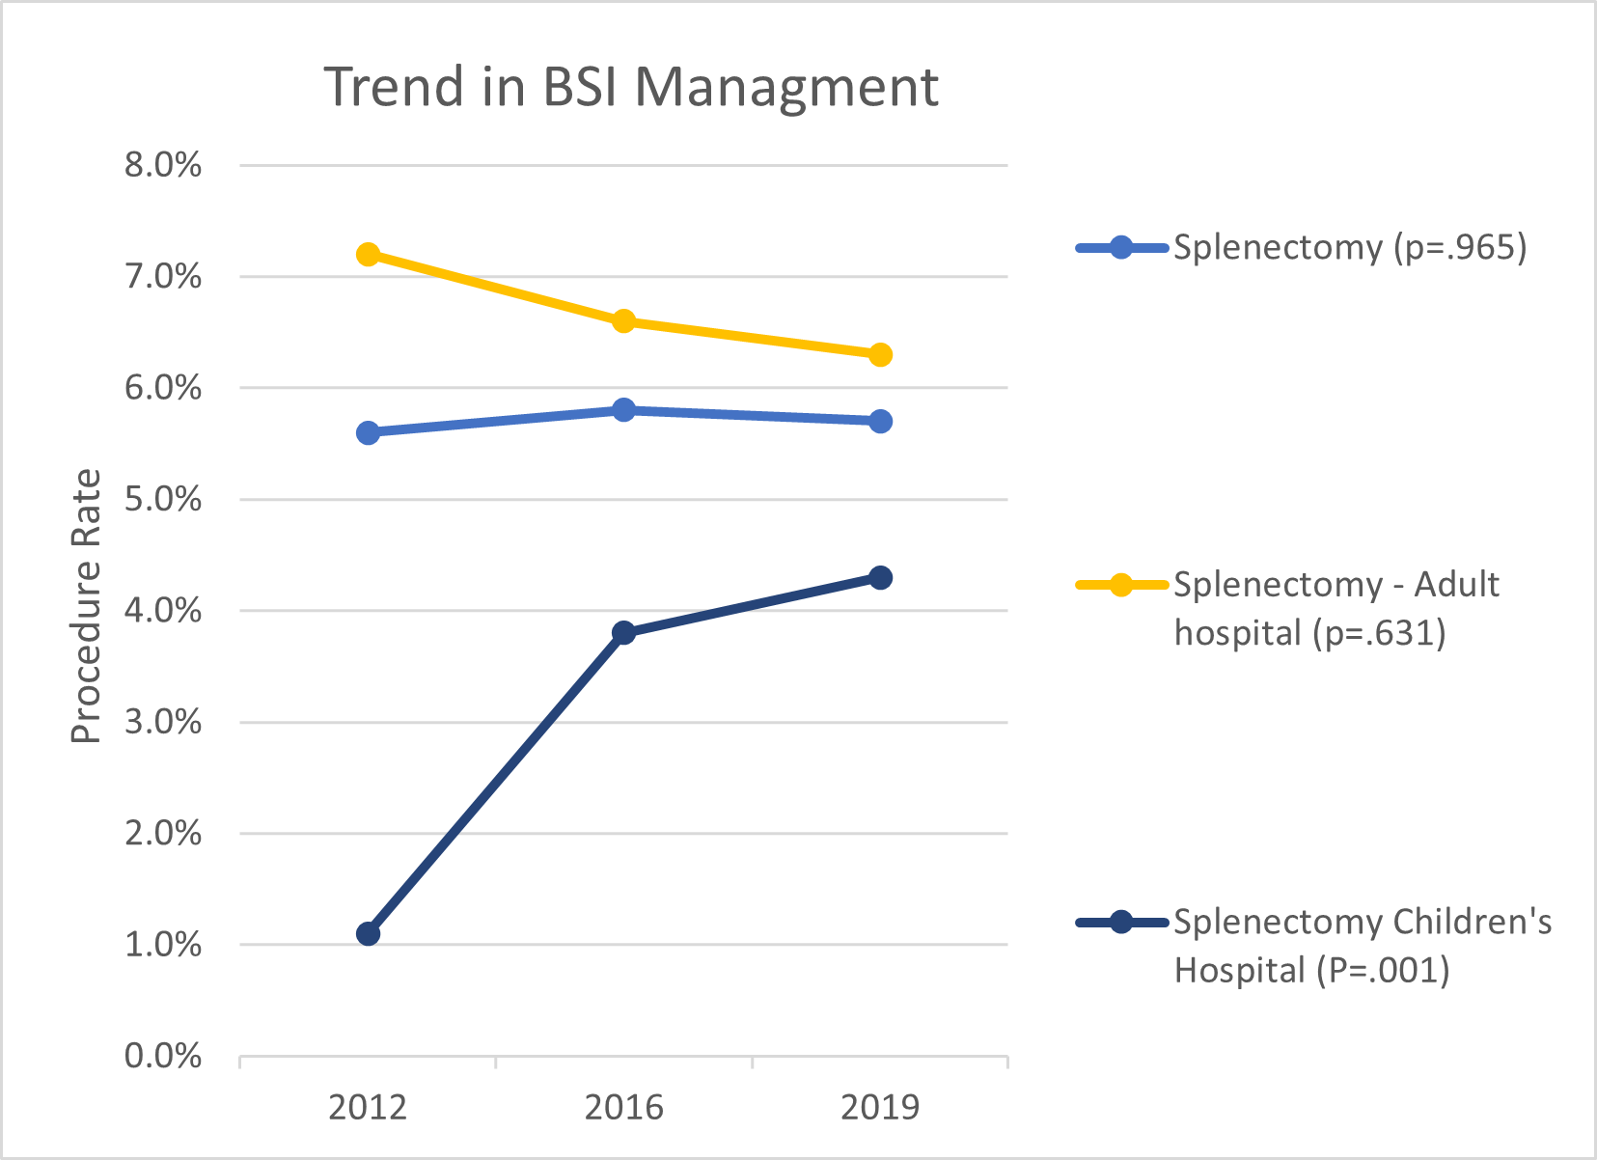
Factors Associated with Operative Management
High grade BSI treated at children’s hospitals increased from 14.6% to 51.7% between 2012 to 2019 (p<0.001
Notes:
When the national rate of splenectomy over time at just adult centers (seen in yellow) we found no statistical significant in rate over the study period. However the rate of splenectomy had a statistically significant increase at chidrens hospitals between 2012 to 2019, from roughly 1% t0 just over 4% per year.
In addition to having a higher rate of splenectomy, pediatric hospitals saw an increase in severity of splenic injury between 2012 to 2019 with high grade blunt splenic injury increasing from 14% of cases to 51.7% of cases.

Slide 14

Financial Outcomes
Operative vs Nonoperative management
Mean charges
$183,000 95%CI[167,000 – 200,000] vs $84,000 95%CI[81,000 – 88,000]
P<0.001
Length of Stay
9.2 days 95%CI[8.4 – 10.2] vs 6.1 days 95%CI[5.9 – 6.3]
P<0.001
Notes:
There has been a historic economic burned associated with operative management in blunt splenic injury. In our series we that the hospital charge among patients managed operatively was almost double that of those managed nonoperatively .
IN addition, patients managed operatively remained hospitalized for approximately 3 days longer than those managed nonoperatively

Slide 15
Limitations
National administrative Database
  Lacking physiologic and laboratory data
  ICD-9 and ICD-10 Coding errors
  Precise timing of clinical diagnosis cannot be determined
  Some incomplete data
Notes:
Our study has several limitation due to the retrospective and database nature
The KIDS database lacks information regarding the physiologic sate of the child such has systolic blood pressure and laboratory data, such as hbg - there fore we are unable to determine if patients who had an operation were hemodynamically unstable
Second diagnostic codes may be inaccurate or incomplete leading to an error in patient assignment
Precise timing of the clinical diagnosis and procedures performed cannot be determined
Some data may be incomplete

Slide 16

Conclusions
Majority of pediatric (≤16 years) splenic injury are treated at adult hospitals
Patients treated at an adult hospital have 2 times the likelihood to undergo splenectomy compared to pediatric hospitals
Pediatric hospitals have seen a significant rise in splenectomy rate – increased severity of patients cared for?
Operative management has a significant financial burden
Notes:
To conclude,
Nearly 75% of children with splenic injury are treated at adult facilities
Being treated at an adult hospital increases the childs risk of undergoing operative management
between 2012 and 2019 pediatric hospital have seen a significant rise in the rate of splenecomty
Operative management is associated with a significant economic burden – in both hospital charges and resources.

Slide 17


Thank you
Questions?

