Slide 1

SCAN for Abuse – Universal EHR-based Child Abuse Screening
Nolan Martin, MS4
Eastern Virginia Medical School
martinnr@evms.edu

Slide 2
Co-Authors
Anneke L. Claypool, PhD
Dupe Diyaolu, MD
Katy Chan, MD
Elizabeth A’Neals LCSW
Karan Iyer, MS
Christopher C. Stewart, MD
Melissa Egge, MD
Krysta Bernacki, MS, CPNP
Michelle Hallinan, MSW, LCSW
Linda Zuo, MS
Urvi Gupta, BS
Navleen Naru, MPH
David Scheinker, PhD
Arden M. Morris, MD, MPH
Margaret L. Brandeau, PhD
Stephanie Chao, MD

Slide 3
Disclosures
Nolan Martin
Has documented no financial relationships to disclose or Conflicts of Interest (COIs) to resolve.
This presentation will not involve discussion of unapproved or off-label, experimental or investigational use.

Slide 4
Definitions
Physical Abuse is the use of physical force such as hitting, kicking, shaking, burning, or other shows of force against a child
Neglect is the failure to meet a child’s basic physical and emotional needs. These needs include housing, food, clothing, education, and access to medical care.
Child Maltreatment includes physical abuse and neglect in addition to sexual and emotional abuse
https://www.cdc.gov/violenceprevention/pdf/CAN-Prevention-Technical-Package.pdf

Slide 5


Why screen for abuse?
1 in 7 children
experienced abuse or neglect in the last year in the US
1,750 children died due to neglect or abuse in 2020
  Mortality rates more than double (25% vs 10%) in recurrent victims of non-accidental trauma (NAT)
81.5% of all child abuse affects children < 5 y/o
  Infants experience NAT at a rate almost 10x that of children overall
https://www.cdc.gov/violenceprevention/childabuseandneglect/fastfact.html
Delaplain et al., 2022. Non-accidental Trauma in Infants: a Review of Evidence-Based Strategies for Diagnosis, Management, and Prevention
Kim, Falcone, 2017. Nonaccidental Trauma in Pediatric Surgery

Slide 6
Fact finding
Literature review
Existing methods
Design
Feasibility analysis
Rollout

Slide 7
Why is screening difficult?
Literature review
Existing methods
Design
Feasibility analysis
Rollout
Nationally:
  Children’s Hospital Association (formerly NACHRI) provides guidelines for setting up a dedicated “Child Protective Team” but no specific screening or risk assessment procedures are provided
  Systematic reviews show low-quality evidence on screening performance, poor accuracy, risk of false positives and negatives
NACHRI – National Association of Children’s Hospitals and Related Institutions
Bailhache et al., 2013. Is early detection of abused children possible? A systematic review of the diagnostic accuracy of the identification of abused children
Chen et al., 2022. Screening tools for child abuse used by healthcare providers: a systematic review

Slide 8
How do we screen currently?
Literature review
Existing methods
Design
Feasibility analysis
Rollout
Flow diagram c/o Anneke Claypool, PhD

Slide 9
How do we screen currently?
Literature review
Existing methods
Design
Feasibility analysis
Rollout
80% of patients enter here
Flow diagram c/o Anneke Claypool, PhD

Slide 10
How do we screen currently?
Literature review
Existing methods
Design
Feasibility analysis
Rollout
Staff interviews (360-bed, Level I Ped Trauma Center):
  Providers rely on individual expertise in escalating suspected NAT with no mandated training or required screening
  Suspected Child Abuse and Neglect (SCAN) Team consists of child abuse pediatricians and social workers who review charts from consulting providers
  No standard or automated process in escalating patients flagged as being “at risk” of abuse

Slide 11
Designing an intervention
Literature review
Existing methods
Design
Feasibility analysis
Rollout
Goals: Increase detection, limit burden of detection
All patients < 5 y/o
Minimal & effective nurse questions
Manageable # to SW
Balanced workload for RN & SW
CPS Report

Slide 12
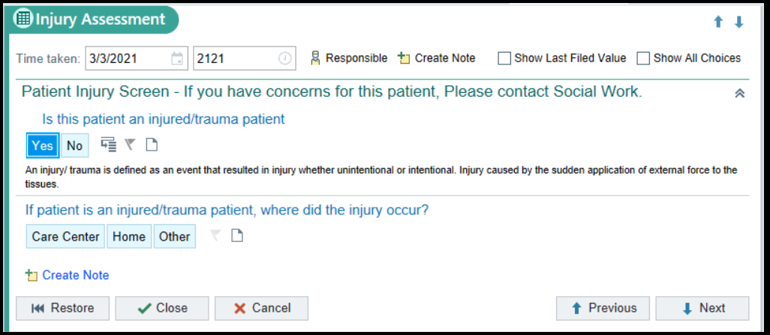
Designing an intervention
Literature review
Existing methods
Design
Feasibility analysis
Rollout
Modified Nationwide Children’s Hospital (Columbus, OH) screening

Slide 13
Feasibility analysis
Literature review
Existing methods
Design
Feasibility analysis
Rollout
Retrospective chart review (data from 2016)
  Screening tool would have referred 131 patients for chart review with SCAN per year
  Captured 48 out of 54 total CPS reports for inpatients
  Tested questionnaire with nursing staff and confirmed SCAN’s capacity for additional chart reviews

Slide 14
Rollout
Literature review
Existing methods
Design
Feasibility analysis
Rollout
Epic implementation
  Implemented into admission nursing workflow
  Optional from November, 2018
  Required from January, 2019
  Collected counts of patients through each step of the screening workflow

Slide 15
Our Intervention
EHR Screening
Bedside nursing
SCAN Review
Suspected Child Abuse and Neglect Team
SCAN Workup
SCAR
CPS
CPS
SCAN – Suspected Child Abuse and Neglect
SCAR – Suspected Child Abuse Report

Slide 16
Results 2019-2021
EHR Screening
14,150 patients screened
SCAN Review
286 (2.0%) positive screens reviewed by SCAN
SCAN Workup
106 (37.0%) required formal workup
SCAR
78 (73.6%) reported
CPS
SCAN – Suspected Child Abuse and Neglect
SCAR – Suspected Child Abuse Report

Slide 17


Cases Caught 2019-2021
EHR Screen
Manual Consult
SCAN
SCAR/CPS

Slide 18


Cases Caught 2019-2021
286 positives
EHR Screen
Manual Consult
166 (58.0%) patients were only identified by screen
18 (6.3%) of these patients were reported to CPS
SCAN
SCAR/CPS

Slide 19
CPS Reporting Rates
1.2 per 1000 patients 5 and under
Pre-intervention hospital reporting rate for physical abuse (2017-2018)
4.2 per 1000 patients 5 and under
Post-intervention hospital reporting rate for physical abuse (2019-2021)
26.9 per 1000 patients 5 and under
Surrounding county reporting rate overall (2020-2021)
https://ccwip.berkeley.edu/childwelfare/reports/AllegationRates/MTSG/r/rts/s

Slide 20
Takeaways
Child Injury Screening:
  Caught cases that may have otherwise been missed
  CPS reporting rates increased following rollout
  Did not place undue burden on nursing or social work staff
  Led to increased awareness of SCAN team and child abuse resources
Future Steps
  Expand screening to emergency department
  Collect substantiation data where possible
  National Epic child abuse screen rollout (now available)

